Slide 1
Blinkit Data Analysis
Steps preformed :
Requirement Gathering
Data Walkthrough and understanding
Connecting Data with Power BI
Data cleaning and Transformation
Data Modelling and Loading
Dax Calculation
Dashboard Layout design
Charts Development and Formatting
Insights Generation.

Slide 2
Blinkit Data Analysis
KPI Requirements :
Total Sales – Overall revenue generated from all item sold
Average Sales – Average revenue per sales
Number of Items – Count of items sold
Average Ratings – Average customer ratings for the item sold

Slide 3
Blinkit Data Analysis
Chart Requirement :
Total sales by fat content – Analysis of fat content on total sales
Chart type – Donut Chart
Total sales by Item type – Identify the performance of different item types on sales
Chart type – Donut Chart
Fat content by outlet for total sales – Compare total sales across different outlet segmented by fat content
Chart type – Stacked column Chart
Total sales by outlet establishment – evaluate how establishment influences total sales
Chart type – Line Chart

Slide 4
Blinkit Data Analysis
Chart Requirement :
Sales by outlet size – Analysis of relation between outlet size and total sales
Chart type – Donut Chart
Sales by outlet location – Access geographic distribution of sales across different location
Chart type – Funnel Map
All Matrices by outlet type – Provide comprehensive view all key matrices (Total Sales, Average sales, number of items, Average rating )
Chart type – Matrix Card

Slide 5
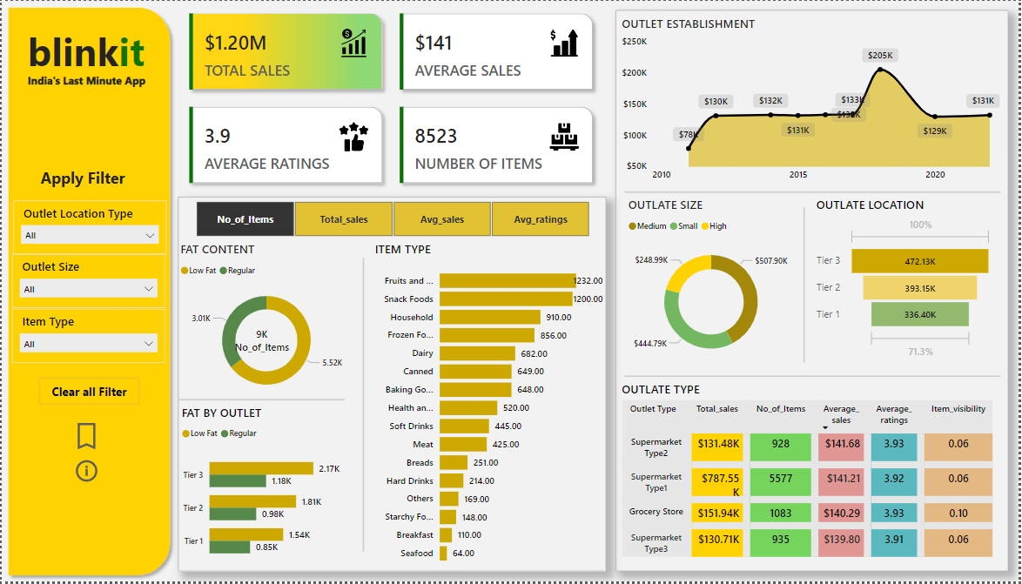
Blinkit Data Analysis
Final View of Dashboard :

